Slide 1
The Reserve at Bradford Park Homeowners’ Association 2020 Annual Meeting
June 24, 2020

Slide 2
Zoom Meeting
Let’s do a quick “Technology Check” to ensure all Bradford Park Residents are able to attend if so desired

Slide 3
Agenda
Board Introduction
HOA-Administrators Overview
2019-2020 Activities & Updates
Financial Review
Covenants / Bylaws Review
Construction Update
2020-2021 Projected Activities
Questions
End of Meeting

Slide 4
2020 HOA Board Introduction
Board Member | Role / Responsibility
Rich Sullivan | Chief Financial Officer / Financials
Noah Bleicher | Director of Operations / Communications
Brian Beam | Director of Development / Infrastructure
Noah, Brian, Rich | Architectural Committee
*Sam Sullivan | HOA Administrators / Covenants

Slide 5
Homeowner Correspondence
When the Board needs to communicate to the Homeowners at large, it will be via one of two ways:
Sent Electronically via the HOA Website or via Email
HOA Website (www.ReserveAtBradfordParkHOA.com)
Has Community information, Utilities contacts, HOA documents (DOD, CCRs, Financials)
This will be the primary form of communication between Board & Homeowners
Email
In order to receive prompt notification of HOA news and information, we encourage you to confirm your email address on the website

Slide 6
HOA Administrators’ Roles & Responsibilities
HOA Management Company Provides:
Financial and Accounting Services
Administrative Services
Property and Community Management
Covenant Supervision and Violation Management
Communication Platform for Homeowners
Renewed Services (Aug 31, 2019), 1-year Contract
HOA Administrators is the primary manager of the Bradford Park HOA on behalf of the Board

Slide 7
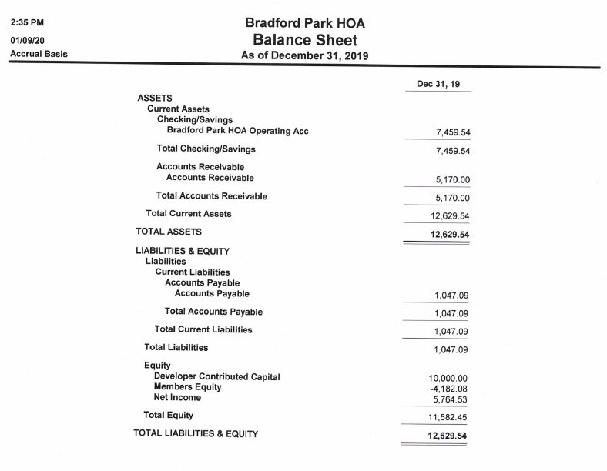
Financial Review – 2019 Balance Sheet
Dedicated HOA bank Account (2017)
Reserve from legacy homeowners
Developer contributed $10k to HOA (seed $)

Slide 8
HOA Financials – 2020 Budget
1/1/20: 64 homes
+26 homes for 2020 (10 so far)
2020 Dues were billed on 1/31/20
Budget assumes all homeowner pay dues
2020 Financials (May) are on RB HOA Website

Slide 9
Administration of Covenants
HOA Covenants are in place for the purpose of enhancing and protecting the value, desirability and attractiveness of the Community as a whole and enhancing the quality of life within the Community
Homeowners are allowed to “use their property” to:
Bring a trailer onsite to prep for a trip
Have materials on driveway for improvements (e.g. Landscaping)
Park cars in the driveway
Proactive Homeowner Communication with HOA-Administrators is paramount for effective covenant management

Slide 10
Within Scope of Board
Common Covenant Violations & Topics include:
Trailers / Boats / RVs parked in driveway for extended period
These items can be parked on property for a 24-hour period except as may be designated by the Association
Yard Maintenance
Stationary Vehicles
Parking
Fences / Sheds / Pools Applications & Approvals

Slide 11
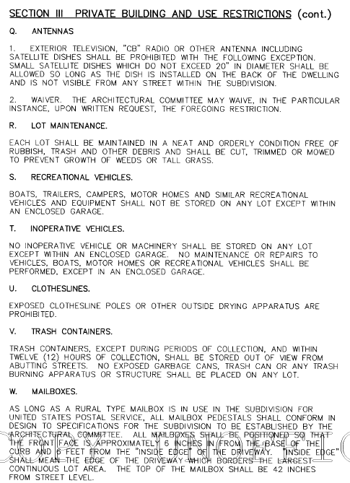
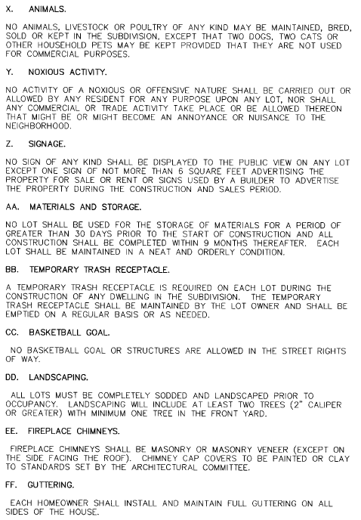
Within Scope of Board – Detailed (Article VIII)

Slide 12
Outside Scope of Board
Common Issues NOT covered by HOA Board Covenants:
Speeding vehicles
Construction traffic/parking
Neighborhood roads and road maintenance
Police or Legal matters

Slide 13
Covenant Violations
HOA Administrators performs MONTHLY neighborhood inspections looking for Covenant violations.
They are also who you should contact should you wish to report a potential Covenant Violation (sam@hoa-administrators.com)
A list of the Bradford Park Covenants can be found in the CCRs on the Bradford Park HOA Website (www.ReserveAtBradfordParkHOA.com)

Slide 14
Construction Update
Construction Traffic / Trash / Parking
Street lights turnover to City of BA 1-20 after 75% buildout
Streets, Water, Sewer all Public Infrastructure City of BA
https://seeclickfix.com/

Slide 15
2020-2021 Areas of Focus
Continued Development of Bradford Park
HOA Handover from Capital Homes to Volunteer Group of Homeowners
Architectural Committee Reviews & Approvals
NOTE: All exterior homeowner projects (fences, sheds, pools, etc) must obtain Architectural Committee approval prior to starting
Upgraded Website & Administration (www.ReserveAtBradfordParkHOA.com)

Slide 16
HOA Handover
There are less than 10 lots remaining for sale
Once the final home is built and closed, Capital Homes will transfer responsibility and administration of the HOA Board to a group of Homeowners
All HOA funds, communications, website administration, etc will then be the responsibility of this new HOA Board (estimated handover in Summer 2021)
Are you interested in joining the HOA Board?
If so, please contact Noah Bleicher (noah.bleicher@capitalhomes.com) and he will reach out as this transition approaches

Slide 17
Questions from Homeowners

Slide 18
Meeting Adjourned But don’t forget to register on the new Bradford Park website! www.ReserveAtBradfordParkHOA.com

