Slide 1
The Reserve at Bradford Park Homeowners’ Association 2021 Annual Meeting
October 13th, 2021

Slide 2
Zoom Meeting
Let’s do a quick “Technology Check” to ensure all Bradford Park Residents are able to attend, if so desired.

Slide 3
Agenda
Board Introduction
HOA-Administrators Overview
2020-2021 Activities & Updates
Financial Review
Covenants / Bylaws Review
Construction Update
Q3 & Q4 Projected Activities
Questions
End of Meeting

Slide 4
2020 HOA Board Introduction
Board Member | Role / Responsibility
Rich Sullivan | Chief Financial Officer / Financials
Noah Bleicher | Director of Operations / Communications
Brian Beam | Director of Development / Infrastructure
Noah, Brian, Rich | Architectural Committee
HOA Admin: Sam Sullivan | HOA Administrators / Covenants

Slide 5
Point and Purpose of an HOA
The Home Owners’ Association (HOA) is a not-for-profit entity charged with financial stewardship and covenant administration on behalf of the Homeowners, among other responsibilities.
All HOA’s have Community documents, known as CCR’s (Covenants, Conditions, & Restrictions). These are the “official rules” of the neighborhood that are filed with the County and are publicly available (and on the website).
One of the main responsibilities of an HOA is to protect the integrity and consistency of the Community by maintaining shared Common Areas and holding Homeowners accountable to the rules of the CCR’s.

Slide 6
3rd Party HOA Manager Roles & Responsibilities
The HOA Board hires a 3rd party company (HOA Administrators) to serve as a point of contact for Homeowners and an execution arm for the Board. HOA Administrators is responsible for:
Financial and Accounting Services
Administrative Services
Property and Community Management
Covenant Supervision and Violation Management
Point of Contact for Homeowners
Initiated Services 08/2020 for 1-year Contract
HOA Administrators is the primary manager of the Reserve at Bradford Park HOA on behalf of the Board

Slide 7
Homeowner Correspondence
When the Board needs to communicate to the Homeowners at large, it will be via one of three ways:
Sent Electronically via the HOA Website (ex: Community Announcements)
Sent Electronically via Email (ex: Arch Committee Applications)
Sent “Snail Mail” via USPS (ex: Annual Dues or Meeting Notices)
The Bradford Park HOA Website is: www.ReserveAtBradfordParkHOA.com
The website is a resource for Community information, Utilities contacts, and HOA documents (DOD, CCR’s, Financials)
It also has a Community Message Board for neighbors to ask questions, post notices, or make announcements

Slide 8
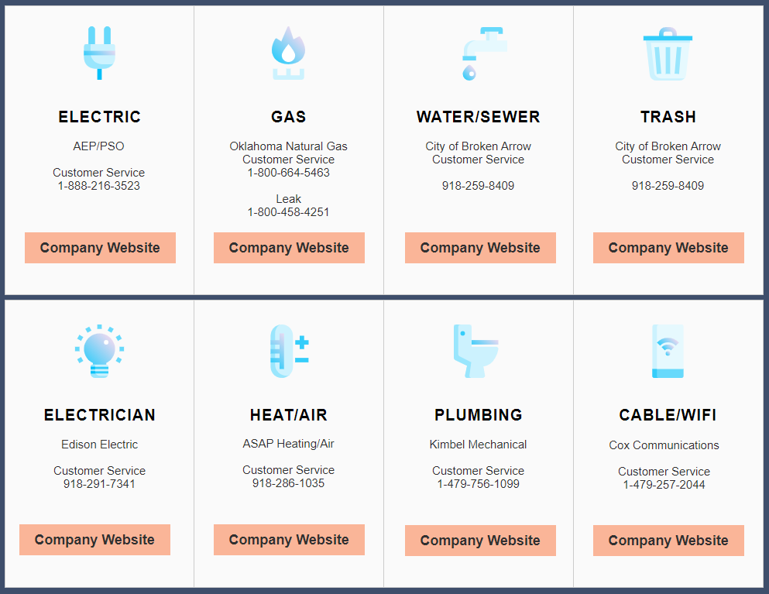
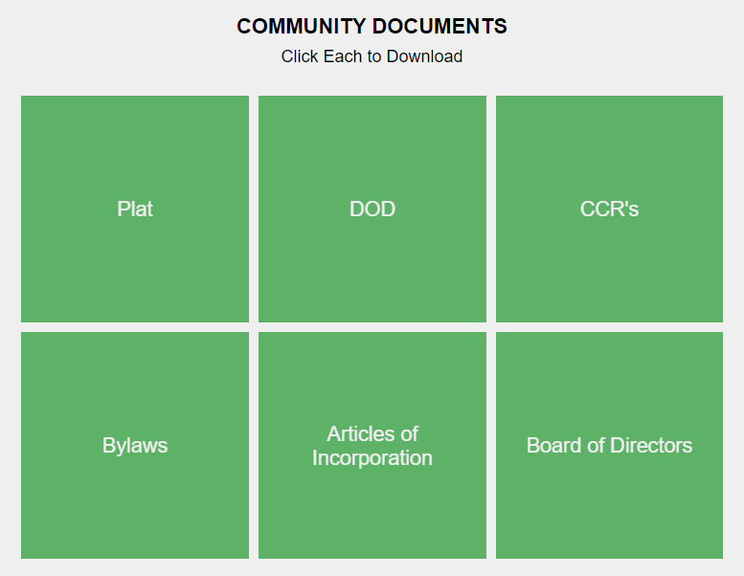
HOA Website
www.ReserveAtBradfordParkHOA.com
This will be the primary forum of communication between Board & Homeowners
Has Community information, Utilities Info, HOA documents (DOD, CCR’s, Financials)

Slide 9
Covenants, Conditions, & Restrictions (CCR’s)

Slide 10
What are HOA Covenants?
HOA Covenants are in place for the purpose of enhancing and protecting the value, desirability, and attractiveness of the Community as a whole and enhancing the quality of life within the Community
They specify Community rules and dictate requirements for Common Area Maintenance (CAM), among other things
The Covenants, Conditions, & Restrictions (CCR;s) are filed with Tulsa County and are available on the HOA Website
Ultimately, they are in place to support the individual Homeowners’ quiet enjoyment of their home and to preserve the financial investment for each member of the Community

Slide 11
Covenant Administration
HOA Administrators performs MONTHLY neighborhood inspections looking for Covenant violations
If you suspect a potential Covenant Violation, please contact Sam Sullivan: sam@hoa-administrators.com
If you are unsure about what is allowed per the CCRs, please read the Community documents first before reaching out to Sam Sullivan
sam@hoa-administrators.com

Slide 12
What is the HOA Board entrusted to do?
Maintain the Common Areas
Hold all Homeowners to the same set of rules (CCR’s)
Ensure vehicles are not parked in driveways for extended periods of time
Communicate with Homeowners and the Municipality (as needed)

Slide 13
What is NOT within the scope of the HOA Board?
Common Issues NOT covered by Aspen Crossing Patio Homes CCR’s:
Speeding vehicles
Construction traffic/parking
Neighborhood roads and road maintenance
Police or Legal matters

Slide 14
Financials

Slide 15
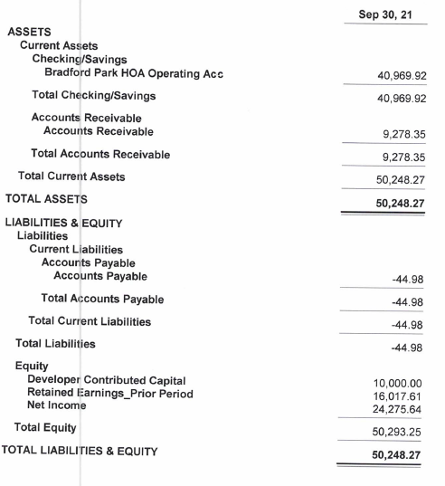
Financial Review – 2021 Balance Sheet
Dedicated HOA bank Account
Developer contributed $10k to HOA (seed $)
Cash is solid with $~41k in operating acct
Receivables are high at ~9k (13 lot owners)

Slide 16
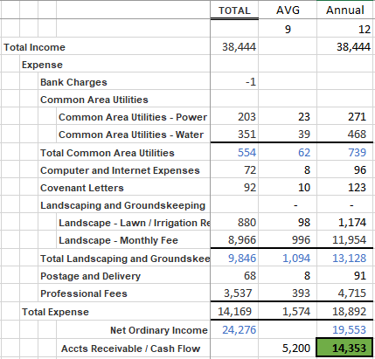
HOA 2021 Financials (Income Stmt Thru September)
1/1/21: 87 homes
+5 in 2021 (so far)
2021 Dues were billed in January 2021
Budget assumes all homeowners pay dues
13 currently outstanding (14%, 5 over one year)
~$1,600 monthly burn rate
CHRG still pays portion of dues (thru 2021)
2021 Financials (Sept) are on RB HOA Website

Slide 17
Should we reduce Annual Dues?
Caution
Too steep a cut creates coverage risk for large negative events or large Accts Receivable

Slide 18
Community Activity

Slide 19
2020 – 2021 Activity
2020 and 2021 saw continued growth of the Community
5 homes sold year to date as of Sept, 2021.
CHRG is almost sold through the Community and will be transitioning the HOA management to the Homeowners in 2022.

Slide 20
Construction Update
This is a Community with active Construction taking place. As such, some construction debris will be present. We appreciate your patience.
If you have any Construction-related Community issues to report (excessive debris, issues with your home, etc) please report via Capital Homes Warranty website: https://www.capitalhomes.com/warranty

Slide 21
2022 HOA Transition
The HOA Board transition will take place in late 2022 and we will post ample notice and information on the HOA website (www.reserveatbradfordparkhoa.com)
We will distribute details ahead of next year’s Annual HOA Meeting and will plan to have the election at next year’s meeting.
We strongly encourage Homeowner participation in their Community’s future!

Slide 22
Questions from Homeowners

Slide 23
Meeting Adjourned And don’t forget to visit the Reserve at Bradford Park HOA website! www.reserveatbradfordparkhoa.com

