Slide 1
The Reserve at Bradford Park
Homeowners’ Association
2022 Annual Meeting
August 24th, 2022

Slide 2
Zoom Meeting
Let’s do a quick “Technology Check” to ensure all Bradford Park Residents are able to attend, if so desired.

Slide 3
Agenda
Board Introduction
Election Preview
HOA Overview
Financial Review
Community Update
New Board Elections
End of Meeting

Slide 4
2020 HOA Board
Introduction
Board Member | Role / Responsibility
Rich Sullivan | Chief Financial Officer / Financials
Noah Bleicher | Director of Operations / Communications
Brian Beam | Director of Development / Infrastructure
Noah, Brian, Rich | Architectural Committee
HOA Admin: Sam Sullivan | HOA Administrators / Covenants

Slide 5
Election Preview
The HOA will turnover to the Homeowners on 1/1/2023
Elections will be held today to elect the four New Directors of the HOA Board.
Nominations/Volunteer window is open now so please come sign up on the sheet in the front and we’ll hold the election later in the meeting

Slide 6

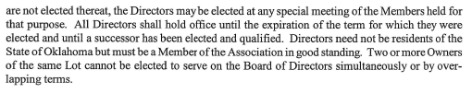
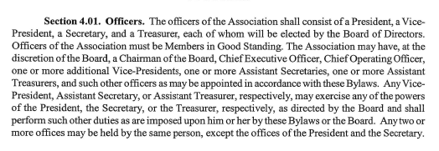
HOA Directors & Roles

Slide 7
Roles of the HOA
  President – Sets agendas, organizes meetings, is primary representative of HOA
  Treasurer – Manages finances, makes payments to vendors, is primary fiduciary of HOA
  Secretary – Scribe, record keeper, website/email, is primary communications person of HOA
  VP – Sub-committee liaison, additional voice at the table, etc
NOTE: Each HOA Board Member has one vote

Slide 8
HOA
Overview

Slide 9
Point and Purpose of an HOA
The Home Owners’ Association (HOA) is a not-for-profit entity charged with financial stewardship and covenant administration on behalf of the Homeowners, among other responsibilities.
All HOA’s have Community documents, known as CCR’s (Covenants, Conditions, & Restrictions). These are the “official rules” of the neighborhood that are filed with the County and are publicly available (and on the website).
One of the main responsibilities of an HOA is to protect the integrity and consistency of the Community by maintaining shared Common Areas and holding Homeowners accountable to the rules of the CCR’s.

Slide 10
3rd Party HOA Manager
Roles & Responsibilities
The HOA Board has previously chosen to hire a 3rd party company (HOA Administrators) to serve as a point of contact for Homeowners and an execution arm for the Board.
HOA Administrators is responsible for:
  Financial and Accounting Services
  Administrative Services
  Property and Community Management
  Covenant Supervision and Violation Management
  Point of Contact for Homeowners
HOA Administrators contract will end when 2022 activities are completed

Slide 11
Homeowner Correspondence
When the Board needs to communicate to the Homeowners at large,
it will be via one of three ways:
  Sent Electronically via the HOA Website (ex: Community Announcements)
  Sent Electronically via Email (ex: Arch Committee Applications)
  Sent “Snail Mail” via USPS (ex: Annual Dues or Meeting Notices)
The Bradford Park HOA Website is: www.ReserveAtBradfordParkHOA.com
  The website is a resource for Community information, Utilities contacts, and HOA documents (DOD, CCR’s, Financials)
  It also has a Community Message Board for neighbors to ask questions, post notices, or make announcements

Slide 12
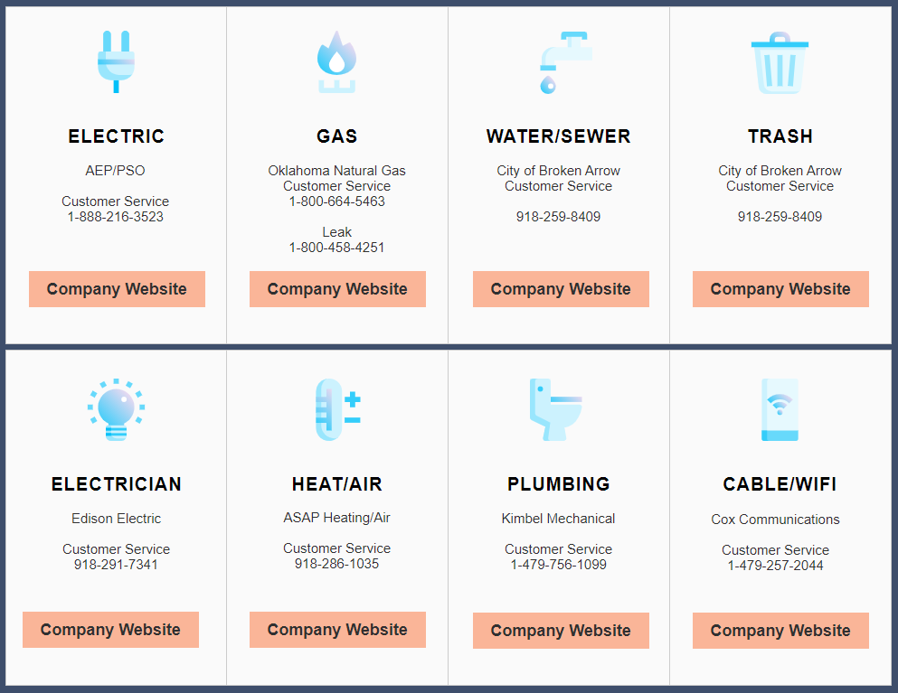
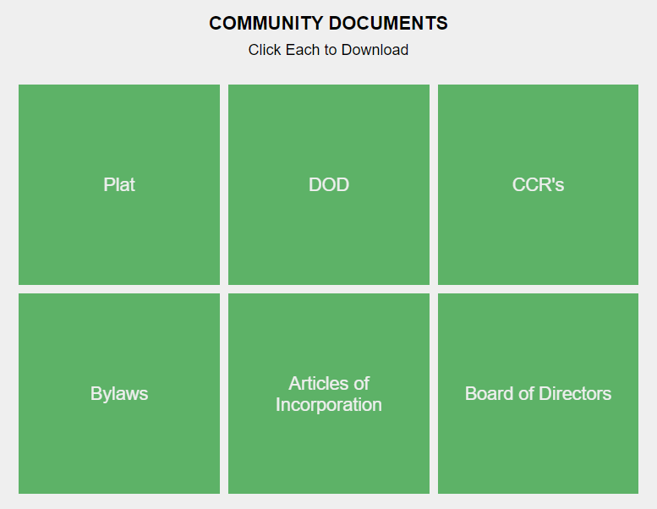
HOA Website
www.ReserveAtBradfordParkHOA.com
Has Community information, Utilities Info, HOA documents (DOD, CCR’s, Financials)
Will be New HOA Board’s decision to keep
  NOTE: Website license expires 2/26/2023

Slide 13
Covenants, Conditions, & Restrictions (CCR’s)

Slide 14
What are HOA Covenants?
  HOA Covenants are in place for the purpose of enhancing and protecting the value, desirability, and attractiveness of the Community as a whole and enhancing the quality
  of life within the Community
  They specify Community rules and dictate requirements for Common Area Maintenance (CAM), among other things
  The Covenants, Conditions, & Restrictions (CCR;s) are filed with Tulsa County and are available on the HOA Website
  Ultimately, they are in place to support the individual Homeowners’ quiet enjoyment of their home and to preserve the financial investment for each member of the Community

Slide 15
What is the HOA Board entrusted to do?
  Maintain the Common Areas
  Hold all Homeowners to the same set of rules (CCR’s)
  Communicate with Homeowners and the Municipality (as needed)

Slide 16
What is NOT within the scope of the HOA Board?
  Common Issues NOT covered by Bradford Park CCR’s:
    Speeding vehicles
    Construction traffic/parking
    Neighborhood roads and road maintenance
    Police or Legal matters

Slide 17
Financials

Slide 18
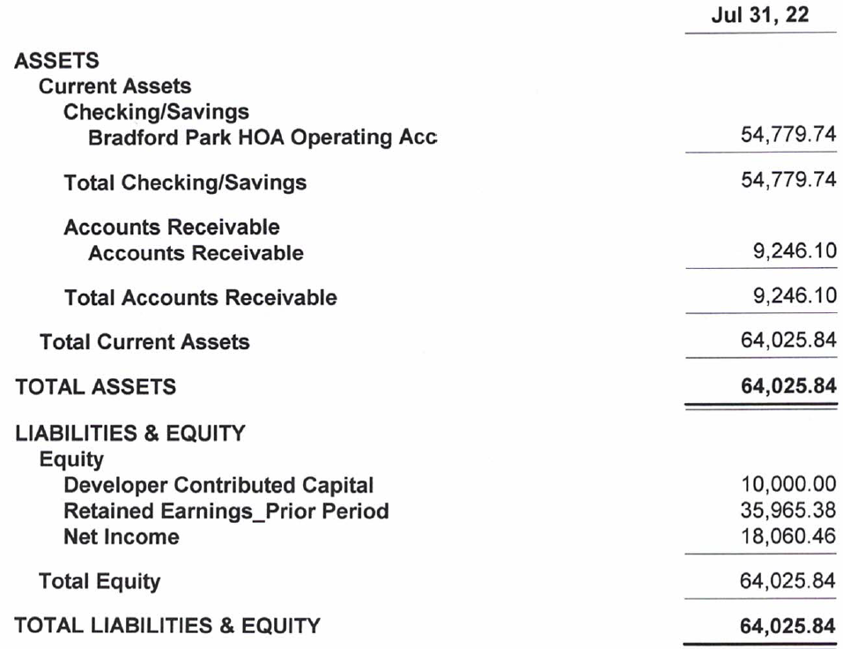
Financial Review – July 31, 2022 Balance Sheet
Dedicated HOA bank Account
Developer contributed $10k to HOA (seed $)
Cash is solid with $~55k in operating acct
Receivables are high at ~9k (15 lot owners, 16%). Improved in August
Two Homeowners have Liens placed on their house

Slide 19
HOA 2021 Financials (Income Stmt Thru July, 2022)
7/31/2022: 95 homes
2022 Dues were billed in January 2021 ($300)
Budget assumes all homeowners pay dues
  15 currently outstanding (16%, 3 over one year)
~$1,722 monthly burn rate
2022 Financials (June) are on RB HOA Website

Slide 20
Community Activity

Slide 21
Construction Update
  This is a Community with limited Construction taking place. As such, some construction debris will be present. We appreciate your patience.
  If you have any Construction-related Community issues to report (excessive debris, issues with your home, etc) please report via Capital Homes Warranty website: https://www.capitalhomes.com/warranty

Slide 22
Remaining Lots
  Lot 3-3 is to remain open for fire access. This will be deeded over to the HOA
  Bradford Park Lot Holding Company, LLC still owns a handful of lots but has intent to sell them to neighboring homeowners or other builders

Slide 23
New Board Elections

Slide 24
How it works:
  Current Board gives brief overview of roles
  Last chance for nominations
  2-min speeches by each candidate
  Voting Period
    Will be by paper ballot & zoom messaging
    NOTE: 1 vote per household in good standing
  Winners are declared

Slide 25
Roles & Responsibilities
  Directors to be elected and then self-appoint:
    President, Treasurer, Secretary, VP
  Scope of New Board:
    All aspects we’ve discussed today
    Financial management
    CCR administration (Covenants / Architectural Committee
    Website / Email Administration (if desired)
New HOA Board Effective Date: 01/01/2023

Slide 26
Voting Rules
  Reminders:
    ONE vote per household per HOA position
    Must be in good standing (dues are current)
    Must provide your name and address with your vote

Slide 27
Nominees for Directors:
    FILL IN NAMES OF CANDIDATES HERE

Slide 28
Voting Period
  Thank you for your patience as we tabulate the results

Slide 29
New HOA Board of Directors:
  A)
  B)
  C)
  D)

Slide 30
Transition Steps:
  Current Board will schedule 1-2 meetings with New Board to discuss transition, answer questions, and begin official transfer process
  Review and sign transfer documents
  Hand over fiduciary responsibilities: 1/1/2023
We will follow up directly with the
New Board to coordinate the transition

Slide 31
Thank you!

Slide 32
Meeting Adjourned www.ReserveAtBradfordParkHOA.com

